Slide 1


Slide 2
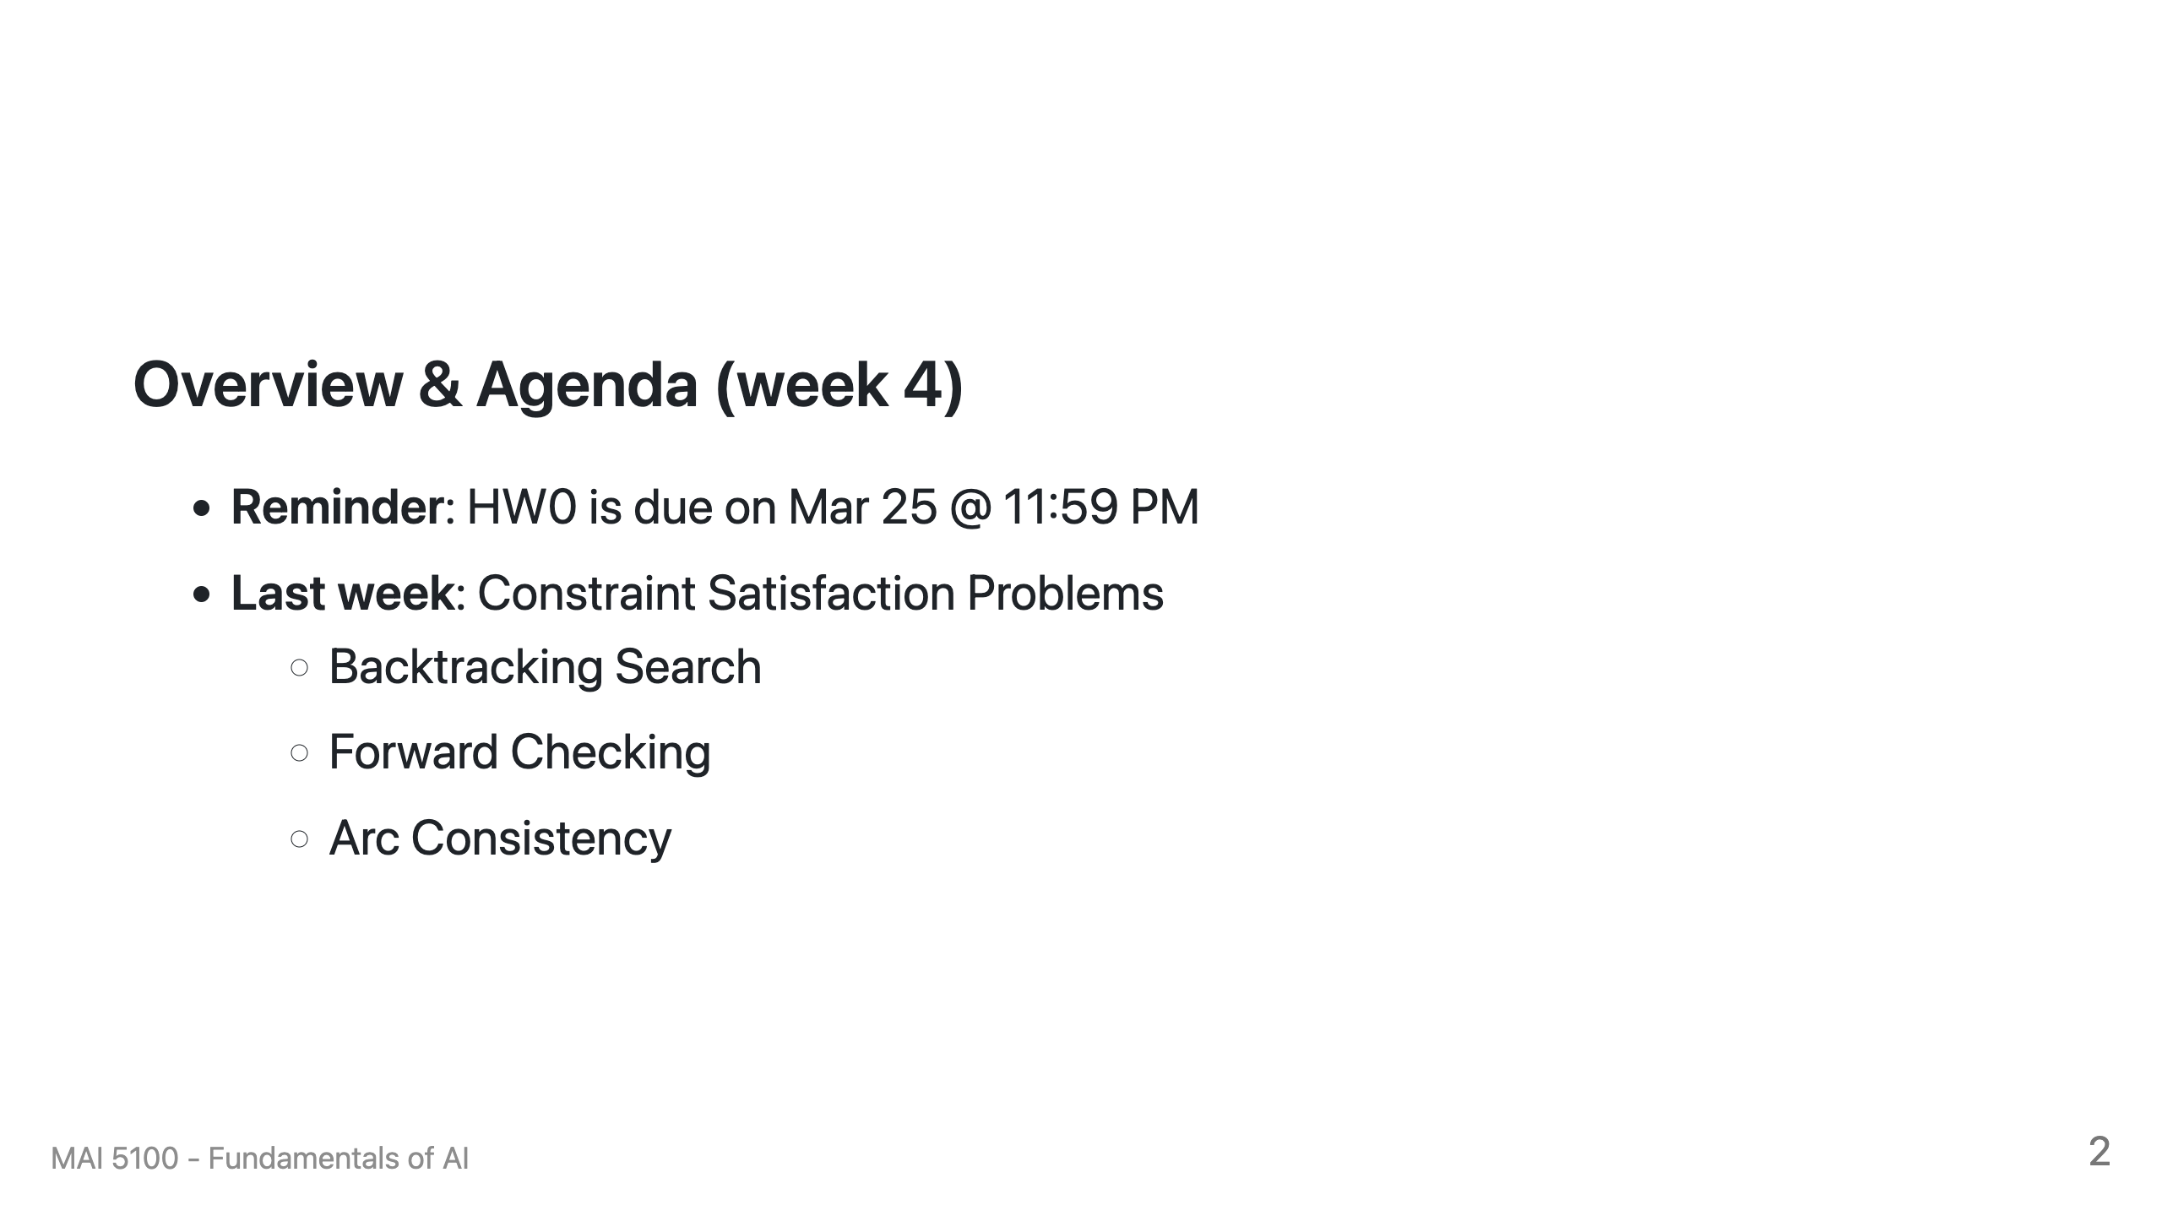

Slide 3
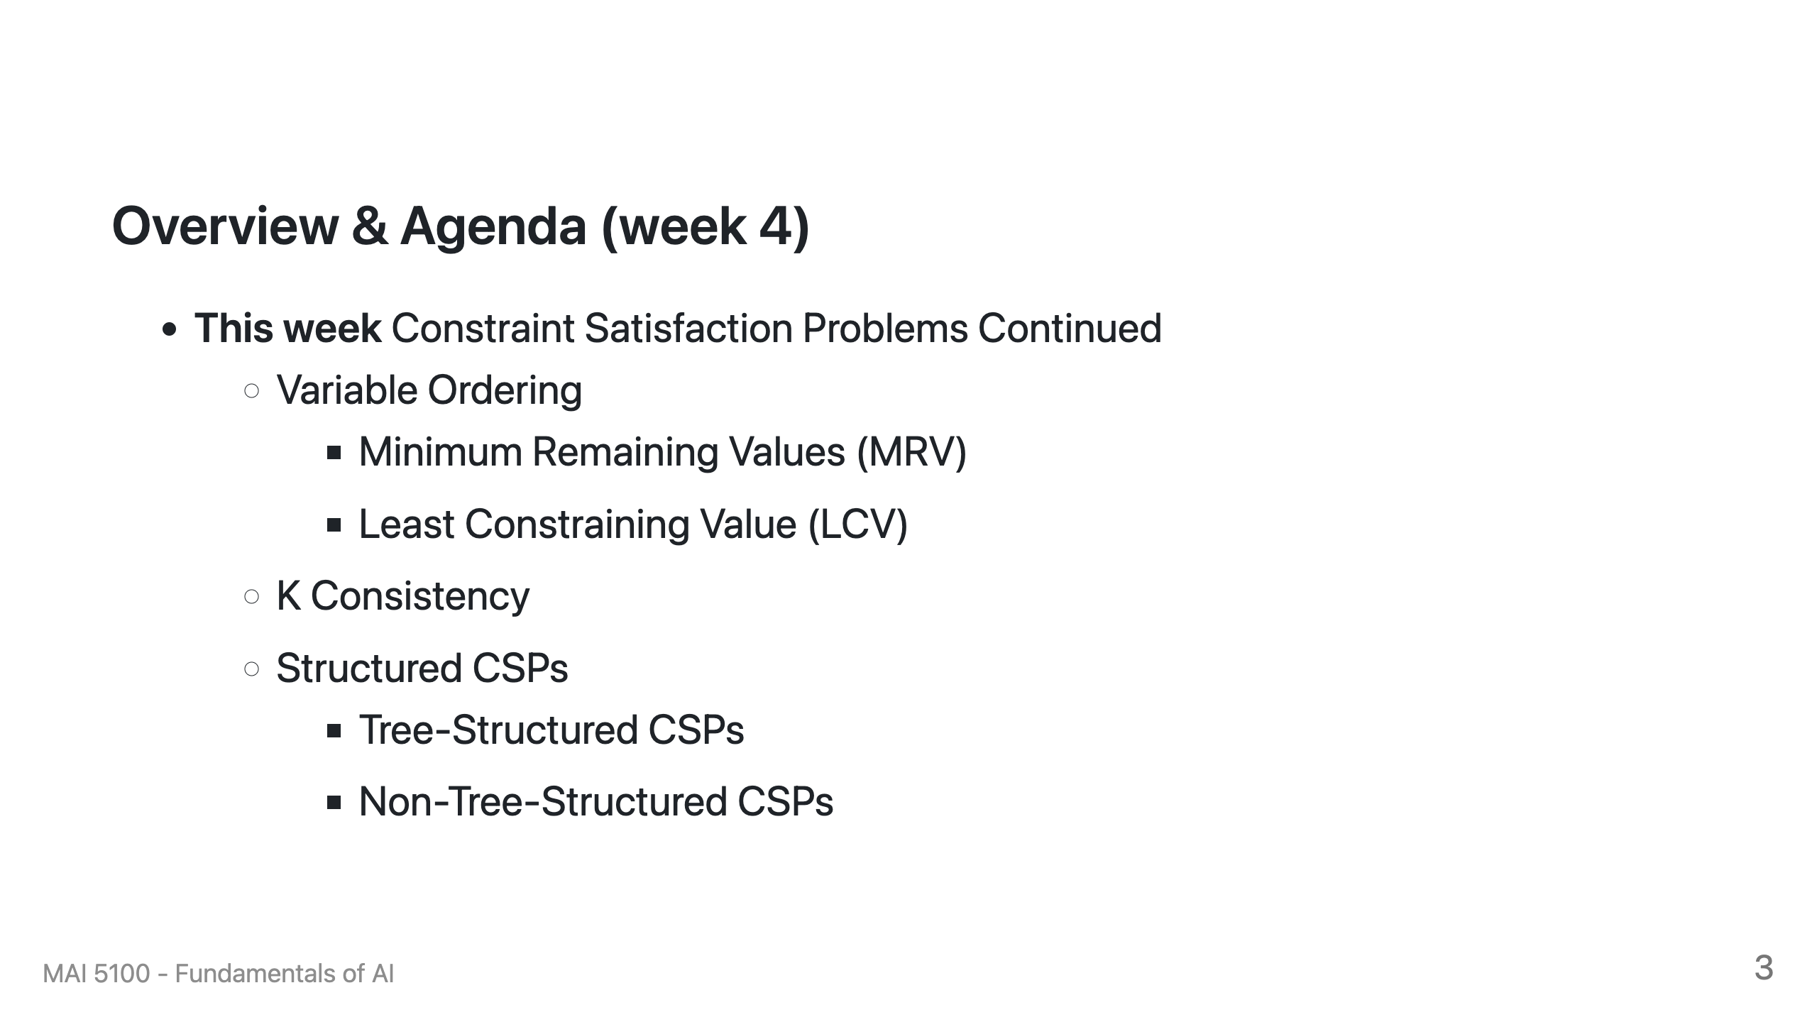

Slide 4
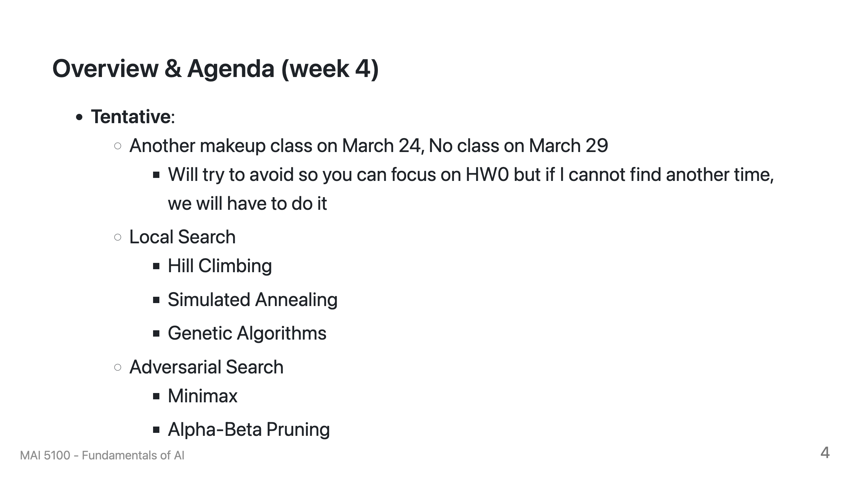

Slide 5
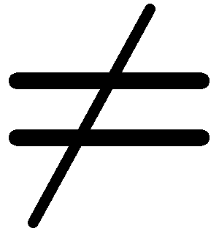

Reminder: CSPs
CSPs:
Variables
Domains
Constraints
Implicit (provide code to compute)
Explicit (provide a list of the legal tuples)
Unary / Binary / N-ary
Goals:
Here: find any solution
Also: find all, find best, etc.
Notes:
- Focus is on finding a complete and consistent solution

Slide 6
Backtracking Search

Slide 7
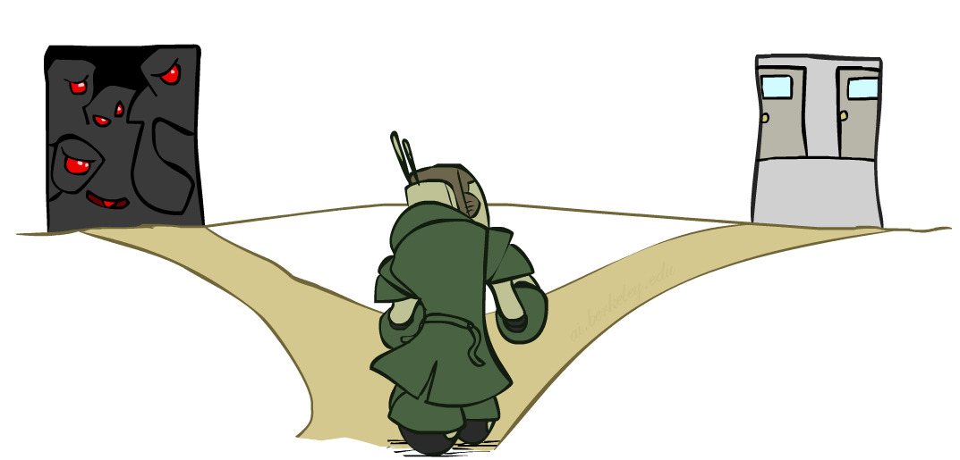

Improving Backtracking
General-purpose ideas give huge gains in speed
… but it’s all still NP-hard
Filtering: Can we detect inevitable failure early?
Ordering:
Which variable should be assigned next? (MRV)
In what order should its values be tried? (LCV)
Structure: Can we exploit the problem structure?

Slide 8

Arc Consistency and Beyond

Slide 9
Arc Consistency of an Entire CSP
A simple form of propagation makes sure all arcs are simultaneously consistent:
Arc consistency detects failure earlier than forward checking
Important: If X loses a value, neighbors of X need to be rechecked!
Must rerun after each assignment!
NT
Q
WA
SA
NSW
V
Remember: Delete from the tail!

Slide 10
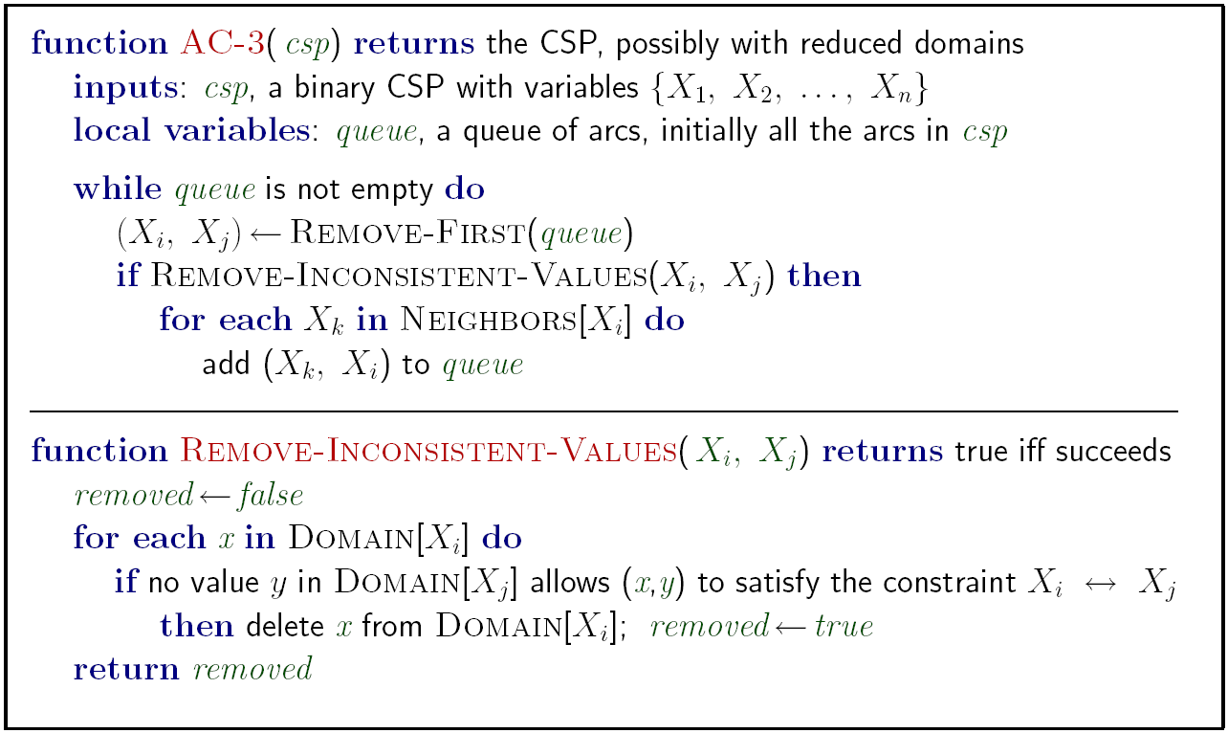
Enforcing Arc Consistency in a CSP
Runtime: O(n²d³), can be reduced to O(n²d²)
… but detecting all possible future problems is NP-hard – why?
[Demo: CSP applet (made available by aispace.org) -- n-queens]
Notes:
Auto-consistency (note initially nothing gets deleted/pruned since there are consistent options for all constraints for initial variable domains)
Flashes whenever something needs to be re-checked

Slide 11
Limitations of Arc Consistency
After enforcing arc consistency:
Can have one solution left
Can have multiple solutions left
Can have no solutions left (and not know it)
Arc consistency still runs inside a backtracking search!
What went wrong here?
Notes:
- What went wrong? Arc consistency works for binary constraints (removing value from tail based on the head). Here we have a 3 way constraint.

Slide 12

Ordering

Slide 13
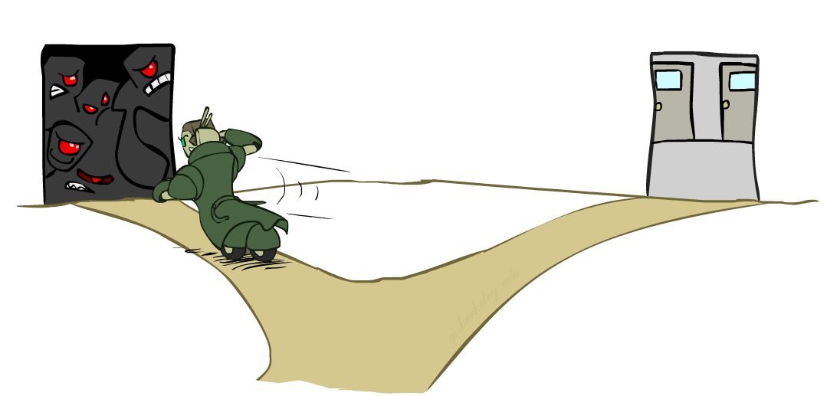
Ordering: Minimum Remaining Values
Variable Ordering: Minimum remaining values (MRV):
Choose the variable with the fewest legal left values in its domain
Why min rather than max?
Also called “most constrained variable”
“Fail-fast” ordering
Notes:
- Fail fast
- Usually ends up being the neighboring nodes

Slide 14
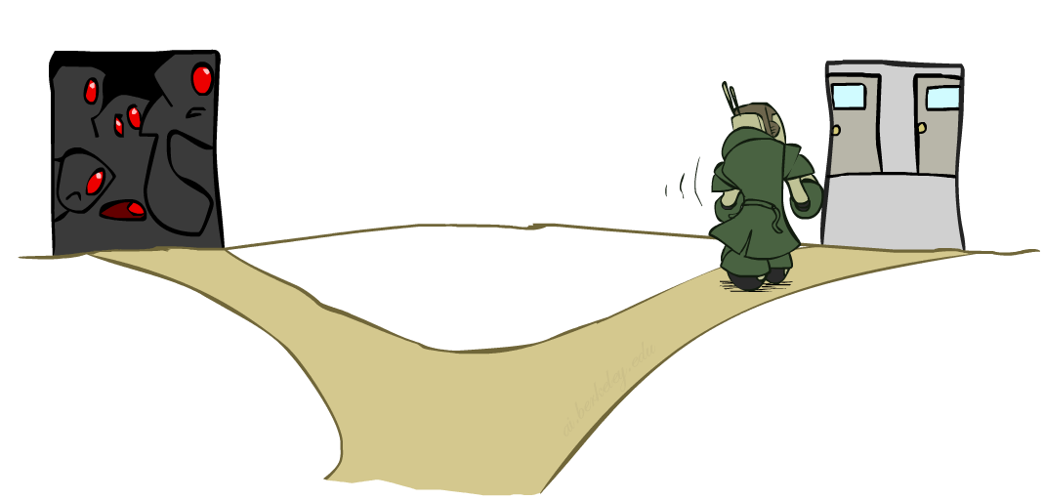
Ordering: Least Constraining Value
Value Ordering: Least Constraining Value
Given a choice of variable, choose the least constraining value
I.e., the one that rules out the fewest values in the remaining variables
Note that it may take some computation to determine this! (E.g., rerunning filtering)
Why least rather than most?
Combining these ordering ideas makes
1000 queens feasible
Notes:
Here the intuition is the pick the value that will result in most amount of remaining options to explore, least likely option to cause a conflict
Don’t constrain yourself with a value
Combine ordering with filtering allows you to solve larger constrained problems.

Slide 15
Demo: Coloring -- Backtracking + Forward Checking + Ordering
Notes:
Demo:
CS188 javascript demos -> source -> exercises -> csps -> CSPs demos -> CSPs demos.html
Settings:
Graph = Complex
Algorithm = Backtracking
Ordering = MRV
Filtering = Forward Checking
Solves already without any need for backtracking
Note: need a bigger problem to illustrate relevance of backtracking+AC+MRV+MCV

Slide 16
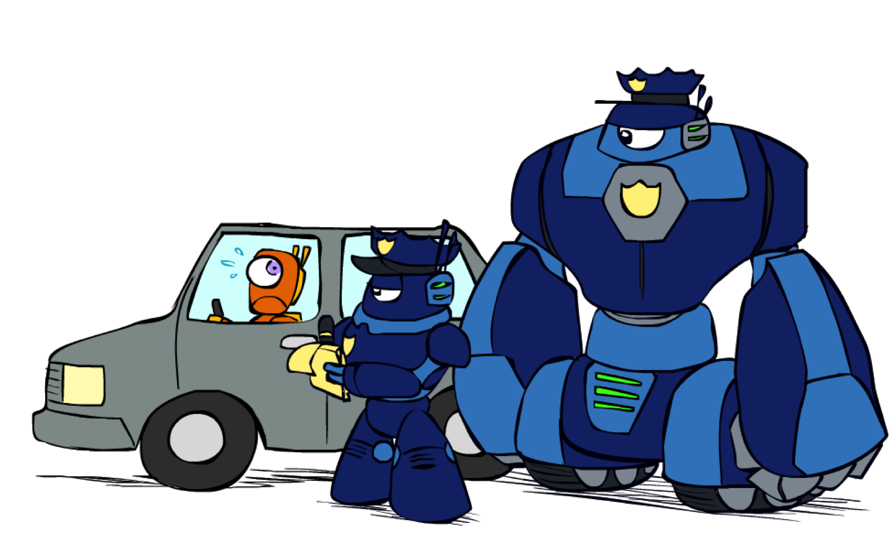
K-Consistency

Slide 17
K-Consistency
Increasing degrees of consistency
1-Consistency (Node Consistency): Each single node’s domain has a value which meets that node’s unary constraints
2-Consistency (Arc Consistency): For each pair of nodes, any consistent assignment to one can be extended to the other
K-Consistency: For each k nodes, any consistent assignment to k-1 can be extended to the k^{th} node.
Higher k more expensive to compute
(You need to know the k=2 case: arc consistency)
Notes:
1 consistency is a constrain on the node value itself with no dependency on other node. E.g color != green
Inductive

Slide 18
Strong K-Consistency
Strong k-consistency: also k-1, k-2, … 1 consistent
Claim: strong n-consistency means we can solve without backtracking!
Why?
Choose any assignment to any variable
Choose a new variable
By 2-consistency, there is a choice consistent with the first
Choose a new variable
By 3-consistency, there is a choice consistent with the first 2
…
Lots of middle ground between arc consistency and n-consistency! (e.g. k=3, called path consistency)
Notes:
- Not used as much, too expensive to compute in practice

Slide 19
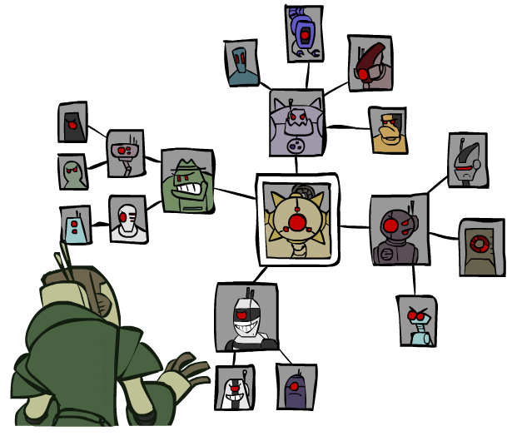
Structure

Slide 20
Problem Structure
Extreme case: independent subproblems
Example: Tasmania and mainland do not interact
Independent subproblems are identifiable as connected components of constraint graph
Suppose a graph of n variables can be broken into subproblems of only c variables:
Worst-case solution cost is O((n/c)(d^{c})), linear in n
E.g., n = 80, d = 2, c =20
2⁸⁰ = 4 billion years at 10 million nodes/sec
(4)(2²⁰) = 0.4 seconds at 10 million nodes/sec
Notes:
Typically not available in practice
Allows for divide and conquer

Slide 21
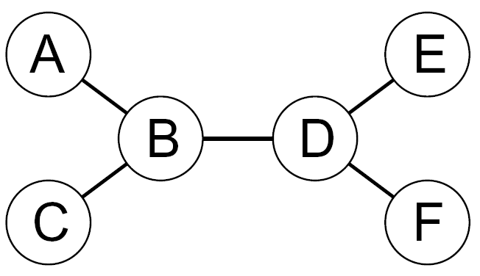
Tree-Structured CSPs
Theorem: if the constraint graph has no loops, the CSP can be solved in O(n d²) time
Compare to general CSPs, where worst-case time is O(d^{n})
This property also applies to probabilistic reasoning (later): an example of the relation between syntactic restrictions and the complexity of reasoning
Notes:
- Tree can be processed much quicker compared to graphs

Slide 22
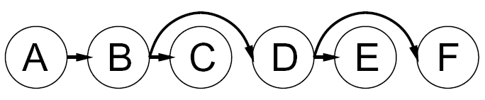
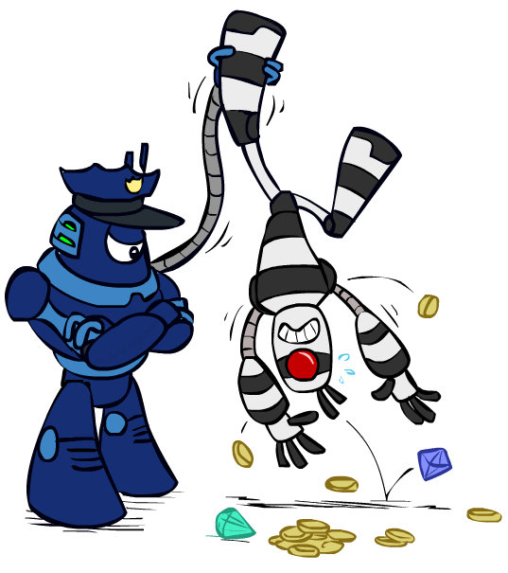

Tree-Structured CSPs
Algorithm for tree-structured CSPs:
Order: Choose a root variable, order variables so that parents precede children
Remove backward: For i = n : 2, apply RemoveInconsistent(Parent(X_{i}),X_{i})
Assign forward: For i = 1 : n, assign X_{i} consistently with Parent(X_{i})
Runtime: O(n d²) (why?)
Notes:
Apply arc consistency backwards
Assign variable forward
In this structure you don’t need to add neigbors back to the queue like AC-3
Doing this ensure you always have head values

Slide 23
Tree-Structured CSPs
Claim 1: After backward pass, all root-to-leaf arcs are consistent
Proof: Each X→Y was made consistent at one point and Y’s domain could not have been reduced thereafter (because Y’s children were processed before Y)
Claim 2: If root-to-leaf arcs are consistent, forward assignment will not backtrack
Proof: Induction on position
Why doesn’t this algorithm work with cycles in the constraint graph?
Note: we’ll see this basic idea again with Bayes’ nets
Notes:
- A cycle creates a non binary constraint result in problems going undetected

Slide 24
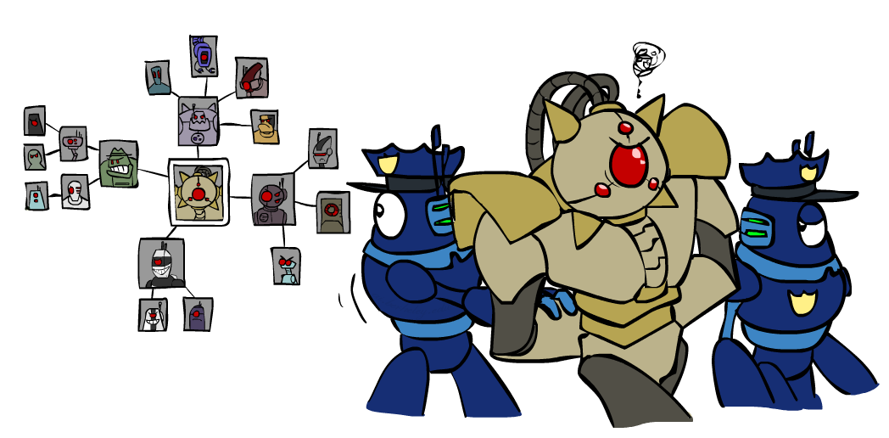
Improving Structure

Slide 25
Nearly Tree-Structured CSPs
Conditioning: instantiate a variable, prune its neighbors' domains
Cutset conditioning: instantiate (in all ways) a set of variables such that the remaining constraint graph is a tree
Cutset size c gives runtime O( (d^{c}) (n-c) d² ), very fast for small c

Slide 26
Cutset Conditioning
Choose a cutset
SA
Instantiate the cutset (all possible ways)
SA
SA
SA
Compute residual CSP for each assignment
Solve the residual CSPs (tree structured)

Slide 27
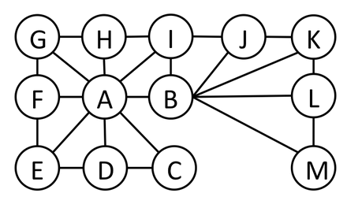
Cutset Quiz
Find the smallest cutset for the graph below.
Notes:
Answer: A & B

Slide 28
Tree Decomposition*
Idea: create a tree-structured graph of mega-variables
Each mega-variable encodes part of the original CSP
Subproblems overlap to ensure consistent solutions
M1
M2
M3
M4
WA
≠
NT
NT
≠
Q
Q
≠
NSW
NSW
≠
V
≠
≠
≠
≠
≠
≠
≠
≠
SA
SA
SA
SA
Agree on shared vars
Agree on shared vars
Agree on shared vars
{(WA=r,SA=g,NT=b),
(WA=b,SA=r,NT=g),
…}
{(NT=r,SA=g,Q=b),
(NT=b,SA=g,Q=r),
…}
Agree: (M1,M2) ∈
{((WA=g,SA=g,NT=g), (NT=g,SA=g,Q=g)), …}
Notes:
- Need to ensure the same values are shared amount meta subproblems

Slide 29
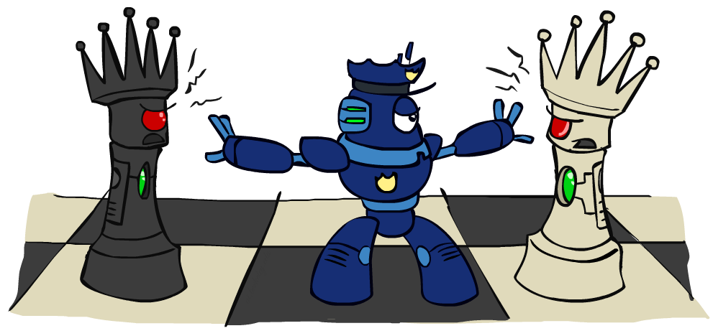
Iterative Improvement

Slide 30
Iterative Algorithms for CSPs
Local search methods typically work with “complete” states, i.e., all variables assigned
To apply to CSPs:
Take an assignment with unsatisfied constraints
Operators reassign variable values
No fringe! Live on the edge.
Algorithm: While not solved,
Variable selection: randomly select any conflicted variable
Value selection: min-conflicts heuristic:
Choose a value that violates the fewest constraints
I.e., hill climb with h(n) = total number of violated constraints
Notes:
- Pick an initial assignment of variables and keep checking what changes reduces the conflicts

Slide 31
Example: 4-Queens
States: 4 queens in 4 columns (4⁴ = 256 states)
Operators: move queen in column
Goal test: no attacks
Evaluation: c(n) = number of attacks
[Demo: n-queens – iterative improvement (L5D1)]
[Demo: coloring – iterative improvement]
Notes:
L5D1 – python demos
Coloring – javascript demos

Slide 32

Video of Demo Iterative Improvement – n Queens

Slide 33
Video of Demo Iterative Improvement – Coloring

Slide 34
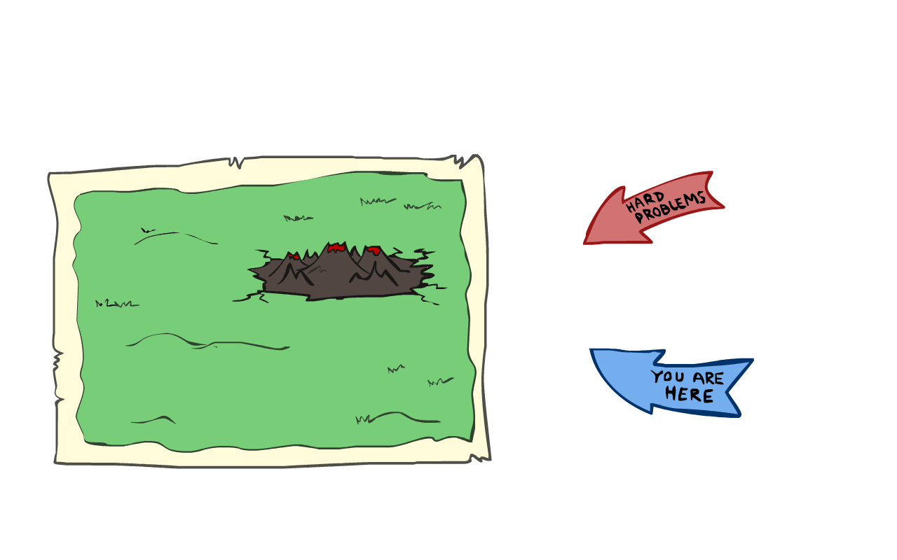
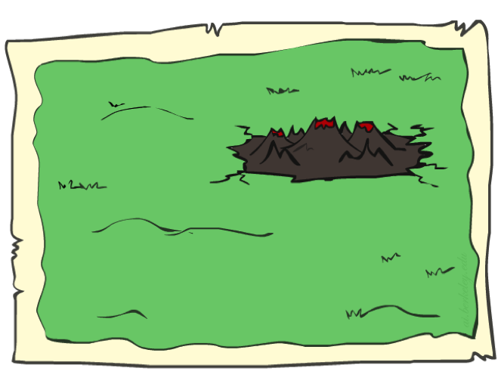
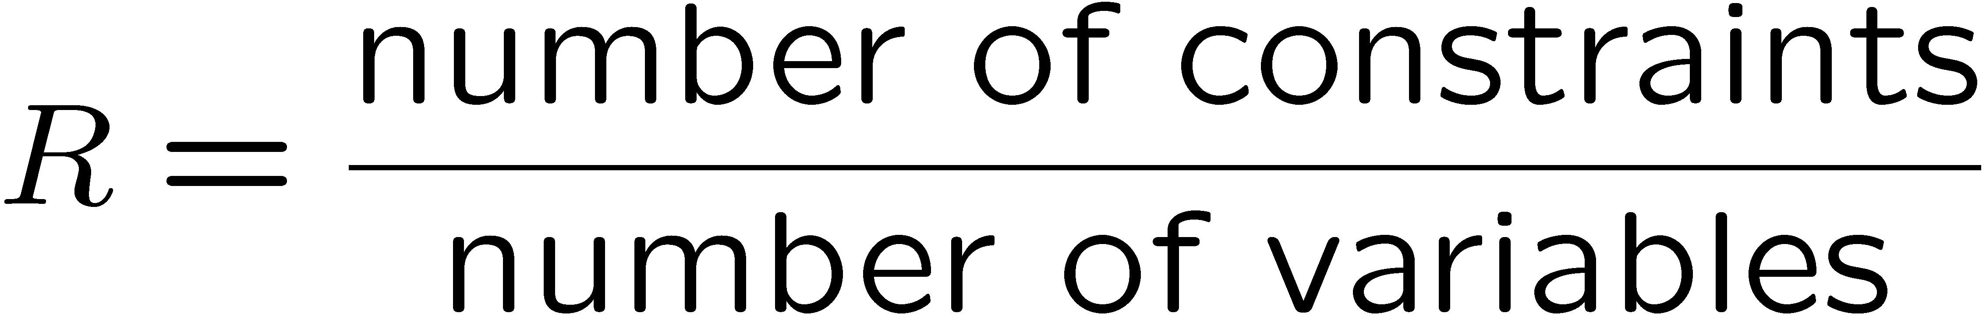
Performance of Min-Conflicts
Given random initial state, can solve n-queens in almost constant time for arbitrary n with high probability (e.g., n = 10,000,000)!
The same appears to be true for any randomly-generated CSP except in a narrow range of the ratio

Slide 35
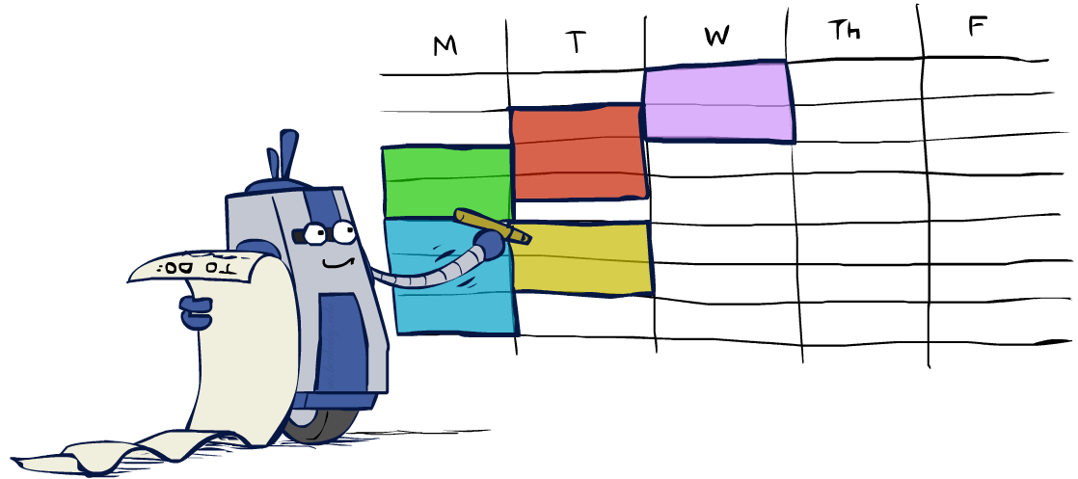
Summary: CSPs
CSPs are a special kind of search problem:
States are partial assignments
Goal test defined by constraints
Basic solution: backtracking search
Speed-ups:
Ordering
Filtering
Structure
Iterative min-conflicts is often effective in practice

Slide 36
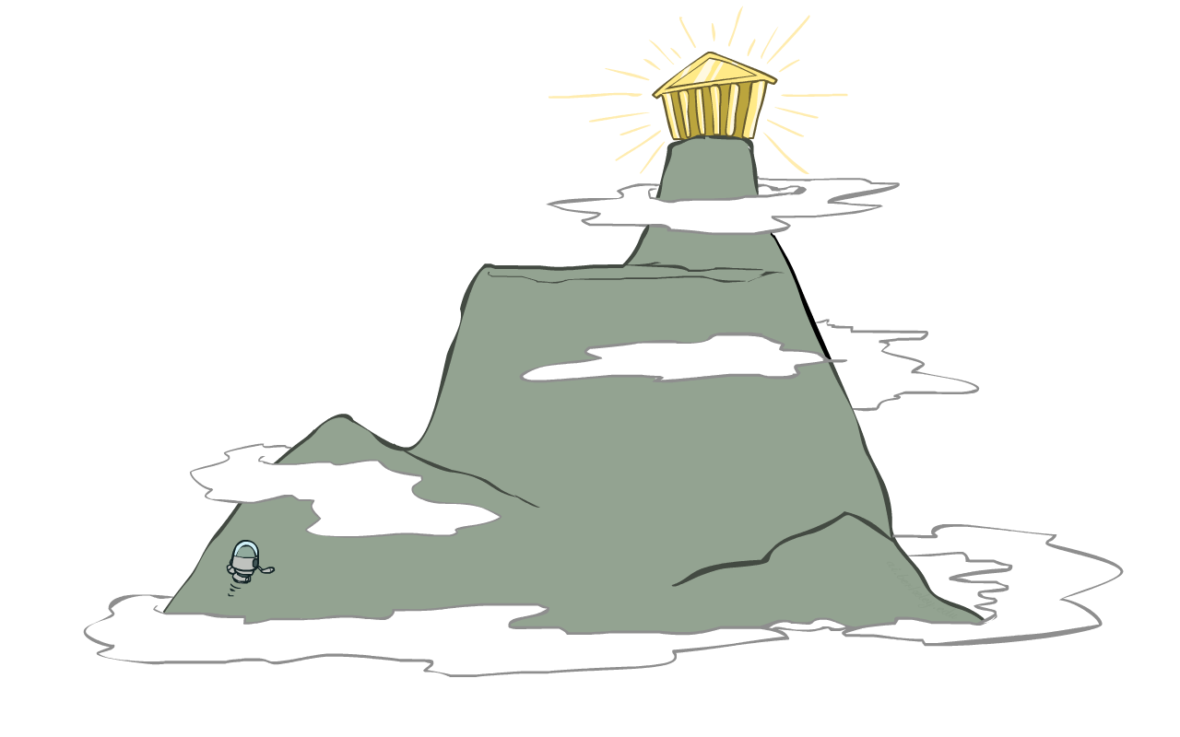
Local Search

Slide 37
Local Search
Tree search keeps unexplored alternatives on the fringe (ensures completeness)
Local search: improve a single option until you can’t make it better (no fringe!)
New successor function: local changes
Generally much faster and more memory efficient (but incomplete and suboptimal)

Slide 38
Hill Climbing
Simple, general idea:
Start wherever
Repeat: move to the best neighboring state
If no neighbors better than current, quit
What’s bad about this approach?
Complete?
Optimal?
What’s good about it?

Slide 39
Hill Climbing Diagram

Slide 40
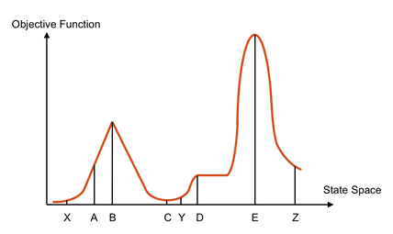
Hill Climbing Quiz
Starting from X, where do you end up ?
Starting from Y, where do you end up ?
Starting from Z, where do you end up ?
Notes:
Answer:
B
D, you have plateu’d = != better
E

Slide 41

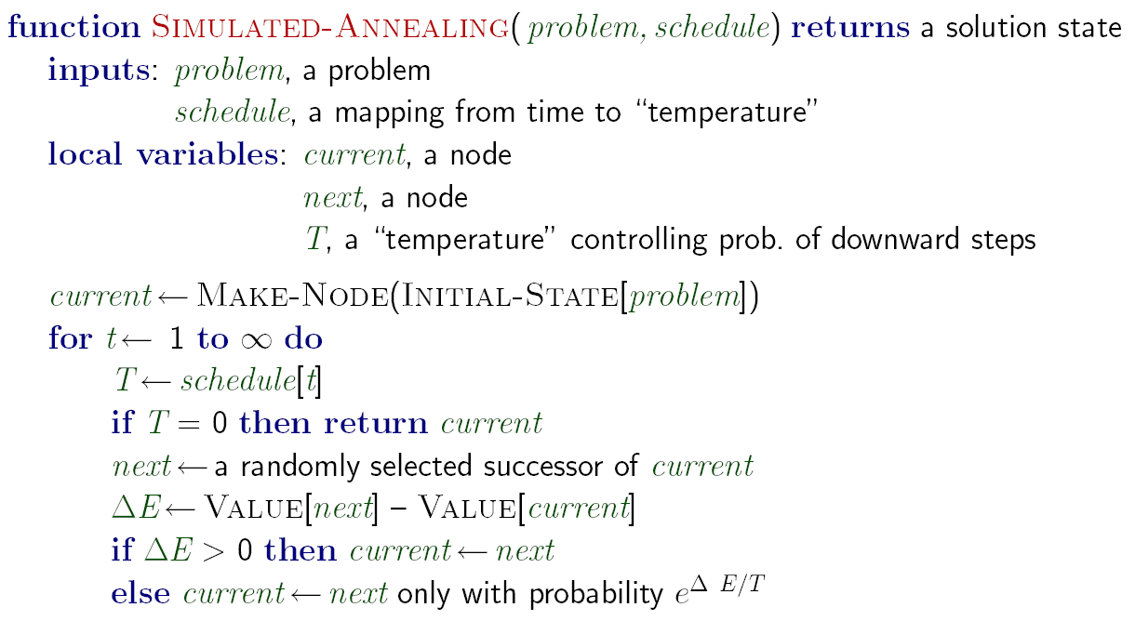
Simulated Annealing
Idea: Escape local maxima by allowing downhill moves
But make them rarer as time goes on

Slide 42
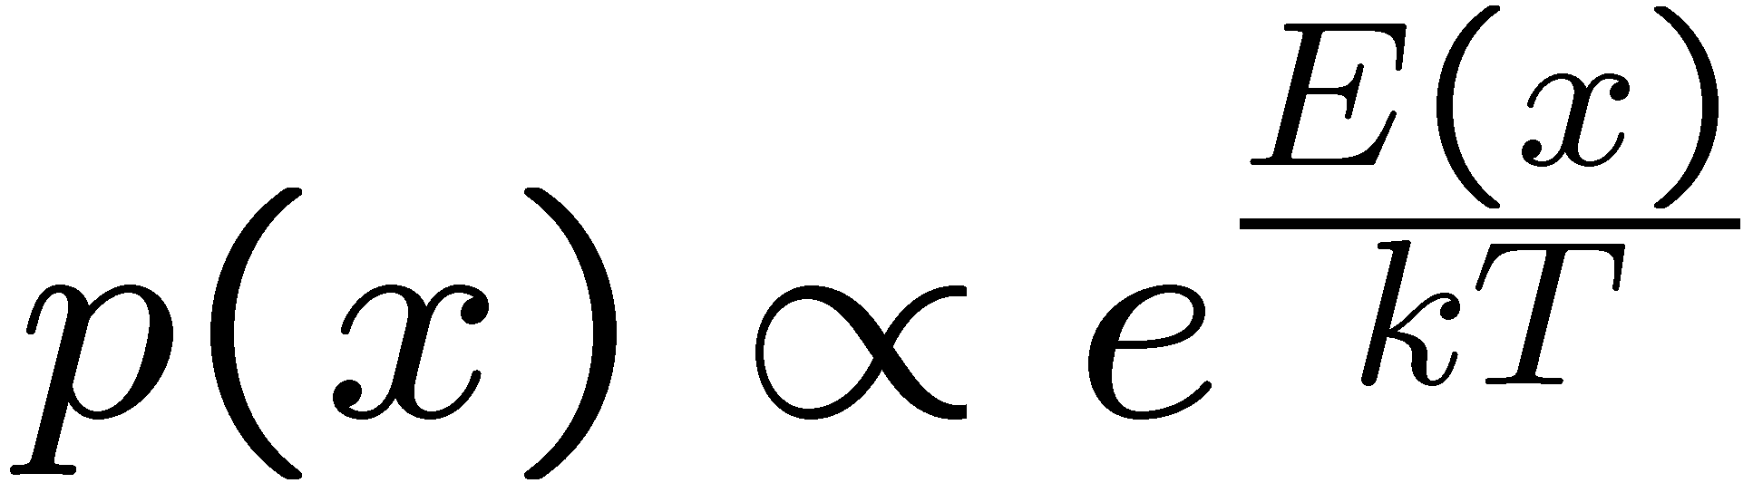
Simulated Annealing
Theoretical guarantee:
Stationary distribution:
If T decreased slowly enough,
will converge to optimal state!
Is this an interesting guarantee?
Sounds like magic, but reality is reality:
The more downhill steps you need to escape a local optimum, the less likely you are to ever make them all in a row
People think hard about ridge operators which let you jump around the space in better ways

Slide 43
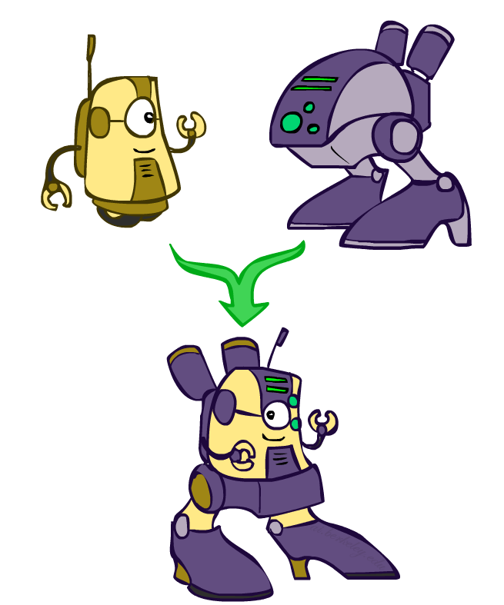
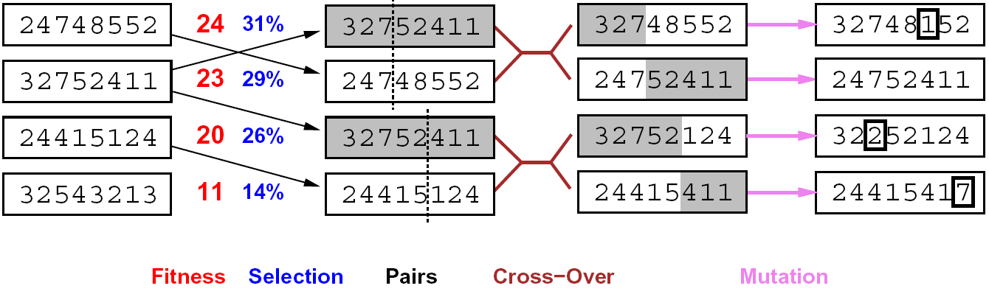
Genetic Algorithms
Genetic algorithms use a natural selection metaphor
Keep best N hypotheses at each step (selection) based on a fitness function
Also have pairwise crossover operators, with optional mutation to give variety
Possibly the most misunderstood, misapplied (and even maligned) technique around

Slide 44
Example: N-Queens
Why does crossover make sense here?
When wouldn’t it make sense?
What would mutation be?
What would a good fitness function be?

Slide 45

CS 188: Artificial Intelligence
Adversarial Search
Instructors: Dan Klein and Pieter Abbeel
University of California, Berkeley
[These slides were created by Dan Klein and Pieter Abbeel for CS188 Intro to AI at UC Berkeley. All CS188 materials are available at http://ai.berkeley.edu.]
Notes:
Please retain proper attribution, including the reference to ai.berkeley.edu. Thanks!

Slide 46
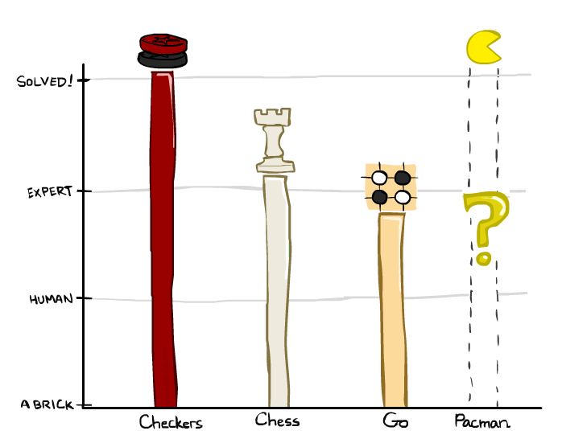
Game Playing State-of-the-Art
Checkers:
1950: First computer player
1959: Samuel’s self-taught program
1995: First computer world champion beat 40 year champion Marion Tinsley *
2007: Checkers solved!
Chess:
1945-1960: Zuse, Wiener, Shannon, Turing, Newell & Simon, McCarthy
1960-1996: gradual improvements
1997: Deep Blue defeats human champion Garry Kasparov
2024: Stockfish rating 3631 (vs 2847 for Magnus Carlsen)
Go:
1968: Zobrist’s program plays legal Go, barely (b>300!)
1968-2005: various ad hoc approaches tried, novice level
2005-2014: Monte Carlo tree search -> strong amateur
2016-2017: AlphaGo defeats human world champions
2022: Human exploits NN weakness to defeat top Go programs
Pacman
Notes:
Solved: We can have a win or draw if two players play optimally

Slide 47
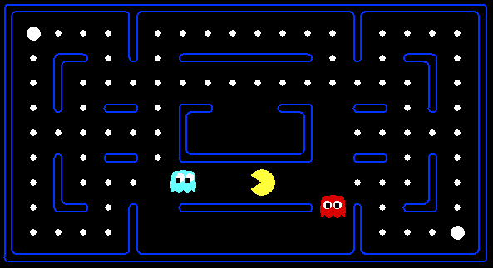
Behavior from Computation
[Demo: mystery pacman (L6D1)]

Slide 48
Video of Demo Mystery Pacman

Slide 49
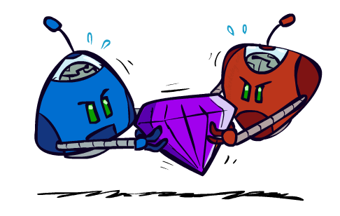
Adversarial Games

Slide 50

Types of Games
Many different kinds of games!
Axes:
Deterministic or stochastic?
One, two, or more players?
Zero sum?
Perfect information (can you see the state)?
Want algorithms for calculating a strategy (policy) which recommends a move from each state
Notes:
- Game: Environment where you have more than one agent

Slide 51

Deterministic Games
Many possible formalizations, one is:
States: S (start at s₀)
Players: P={1...N} (usually take turns)
Actions: A (may depend on player / state)
Transition Function: SxA → S
Terminal Test: S → {true,false}
Terminal Utilities: SxP → R
Solution for a player is a policy: S → A

Slide 52

Zero-Sum Games
Zero-Sum Games
Agents have opposite utilities (values on outcomes)
Lets us think of a single value that one maximizes and the other minimizes
Adversarial, pure competition
General Games
Agents have independent utilities (values on outcomes)
Cooperation, indifference, competition, and more are all possible
More later on non-zero-sum games

Slide 53

Adversarial Search

Slide 54
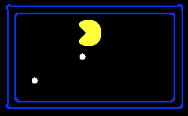
Single-Agent Trees
8
2
0
…
2
6
…
4
6
Notes:
1 dimensional pacman example
Lets say the prize of getting to the goal is 10 points
You lose a point for each step you take

Slide 55
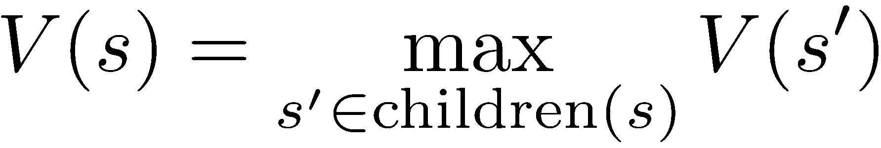
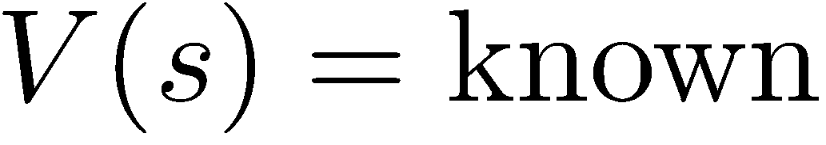
Value of a State
Value of a state: The best achievable outcome (utility) from that state
Non-Terminal States:
8
2
0
…
2
6
…
4
6
Terminal States:

Slide 56

Adversarial Game Trees
-20
-8
…
-18
-5
…
-10
+4
-20
+8

Slide 57
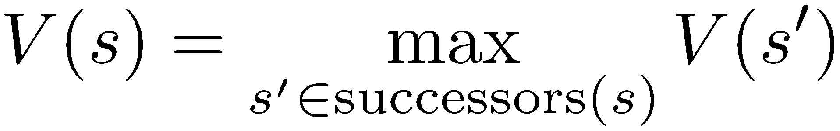
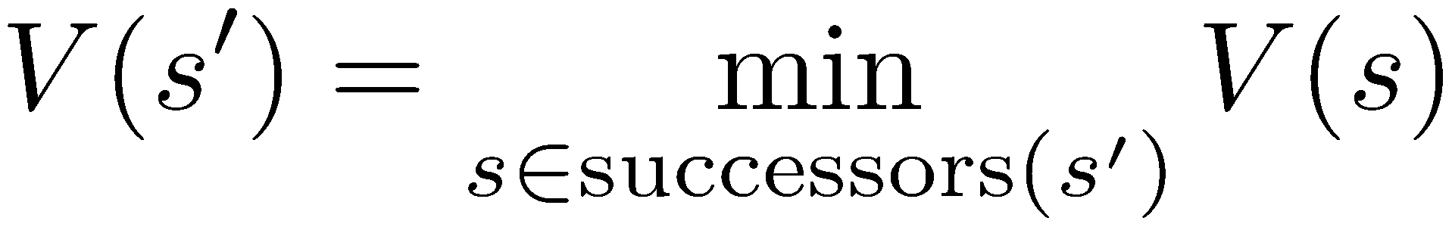
Minimax Values
States Under Agent’s Control:
States Under Opponent’s Control:
-8
-5
-10
+8
Terminal States:

Slide 58

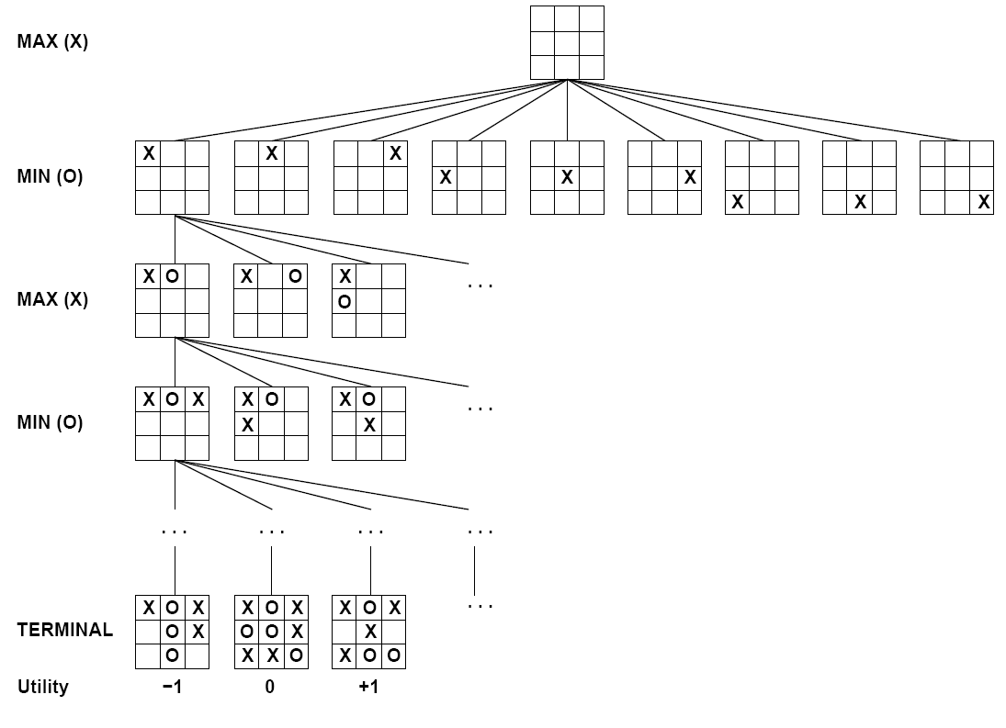

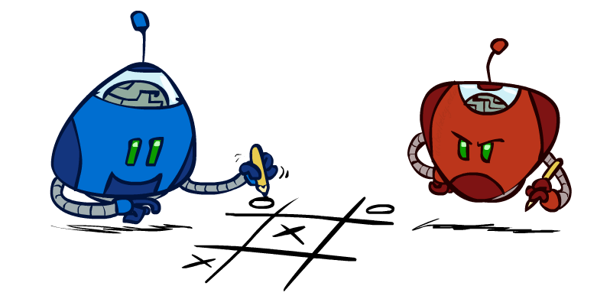
Tic-Tac-Toe Game Tree

Slide 59
Adversarial Search (Minimax)
Deterministic, zero-sum games:
Tic-tac-toe, chess, checkers
One player maximizes result
The other minimizes result
Minimax search:
A state-space search tree
Players alternate turns
Compute each node’s minimax value: the best achievable utility against a rational (optimal) adversary
Minimax values: computed recursively
5
max
2
5
min
8
2
5
6
Terminal values: part of the game

Slide 60
Minimax Implementation
def max-value(state):
initialize v = -∞
for each successor of state:
v = max(v, min-value(successor))
return v
def min-value(state):
initialize v = +∞
for each successor of state:
v = min(v, max-value(successor))
return v

Slide 61
Minimax Implementation (Dispatch)
def value(state):
if the state is a terminal state: return the state’s utility
if the next agent is MAX: return max-value(state)
if the next agent is MIN: return min-value(state)
def max-value(state):
initialize v = -∞
for each successor of state:
v = max(v, value(successor))
return v
def min-value(state):
initialize v = +∞
for each successor of state:
v = min(v, value(successor))
return v
Notes:
Pick an order for two reasons: sequential processor and pruning

Slide 62
Minimax Example
3
12
8
2
4
6
14
5
2

Slide 63
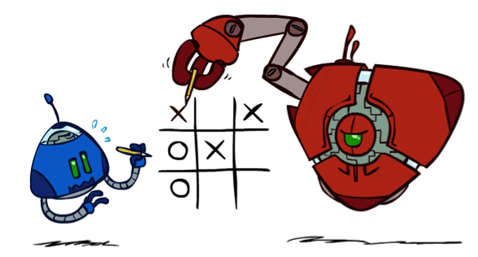

Minimax Properties
max
min
10
10
9
100
Optimal against a perfect player. Otherwise?
[Demo: min vs exp (L6D2, L6D3)]

Slide 64
Minimax Efficiency
How efficient is minimax?
Just like (exhaustive) DFS
Time: O(b^{m})
Space: O(bm)
Example: For chess, b ≈ 35, m ≈ 100
Exact solution is completely infeasible
But, do we need to explore the whole tree?

Slide 65
Video of Demo Min vs. Exp (Min)

Slide 66
Video of Demo Min vs. Exp (Exp)

Slide 67

Resource Limits

Slide 68
Resource Limits
Problem: In realistic games, cannot search to leaves!
Solution: Depth-limited search
Instead, search only to a limited depth in the tree
Replace terminal utilities with an evaluation function for non-terminal positions
Example:
Suppose we have 100 seconds, can explore 10K nodes / sec
So can check 1M nodes per move
α-β reaches about depth 8 – decent chess program
Guarantee of optimal play is gone
More plies makes a BIG difference
Use iterative deepening for an anytime algorithm
max
4
-2
4
min
-1
-2
4
9
?
?
?
?

Slide 69


Depth Matters
Evaluation functions are always imperfect
The deeper in the tree the evaluation function is buried, the less the quality of the evaluation function matters
An important example of the tradeoff between complexity of features and complexity of computation
[Demo: depth limited (L6D4, L6D5)]

Slide 70
Video of Demo Limited Depth (2)

Slide 71
Video of Demo Limited Depth (10)

Slide 72
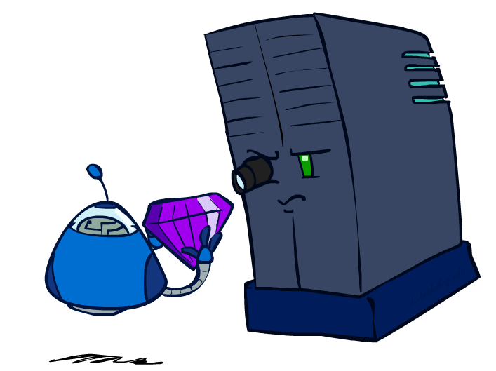
Evaluation Functions

Slide 73
Evaluation Functions
Evaluation functions score non-terminals in depth-limited search
Ideal function: returns the actual minimax value of the position
In practice: typically weighted linear sum of features:
e.g. f₁(s) = (num white queens – num black queens), etc.

Slide 74




Evaluation for Pacman
[Demo: thrashing d=2, thrashing d=2 (fixed evaluation function), smart ghosts coordinate (L6D6,7,8,10)]

Slide 75
Video of Demo Thrashing (d=2)

Slide 76
Why Pacman Starves
A danger of replanning agents!
He knows his score will go up by eating the dot now (west, east)
He knows his score will go up just as much by eating the dot later (east, west)
There are no point-scoring opportunities after eating the dot (within the horizon, two here)
Therefore, waiting seems just as good as eating: he may go east, then back west in the next round of replanning!

Slide 77
Video of Demo Thrashing -- Fixed (d=2)

Slide 78
Video of Demo Smart Ghosts (Coordination)

Slide 79
Video of Demo Smart Ghosts (Coordination) – Zoomed In

Slide 80
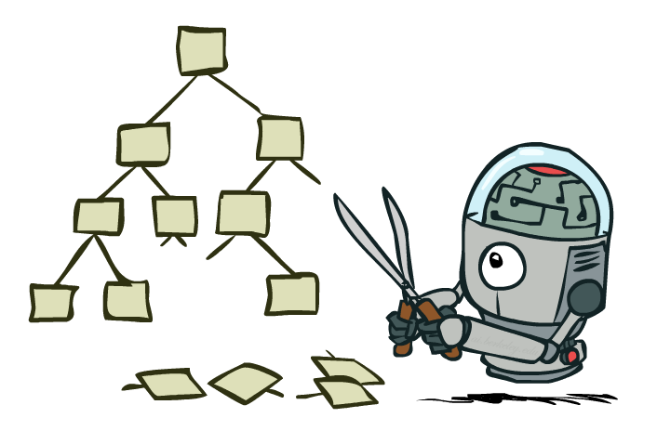
Game Tree Pruning

Slide 81
Minimax Example
3
12
8
2
4
6
14
5
2

Slide 82
Minimax Pruning
3
12
8
2
14
5
2
Notes:
- Order matters!!!

Slide 83
Alpha-Beta Pruning
General configuration (MIN version)
We’re computing the MIN-VALUE at some node n
We’re looping over n’s children
n’s estimate of the childrens’ min is dropping
Who cares about n’s value? MAX
Let a be the best value that MAX can get at any choice point along the current path from the root
If n becomes worse than a, MAX will avoid it, so we can stop considering n’s other children (it’s already bad enough that it won’t be played)
MAX version is symmetric
MAX
MIN
a
MAX
MIN
n

Slide 84
Alpha-Beta Implementation
α: MAX’s best option on path to root
β: MIN’s best option on path to root
def max-value(state, α, β):
initialize v = -∞
for each successor of state:
v = max(v, value(successor, α, β))
if v ≥ β return v
α = max(α, v)
return v
def min-value(state , α, β):
initialize v = +∞
for each successor of state:
v = min(v, value(successor, α, β))
if v ≤ α return v
β = min(β, v)
return v
Notes:
Pick an order for two reasons: sequential processor and pruning

Slide 85
Alpha-Beta Pruning Properties
This pruning has no effect on minimax value computed for the root!
Values of intermediate nodes might be wrong
Important: children of the root may have the wrong value
So the most naïve version won’t let you do action selection
Good child ordering improves effectiveness of pruning
With “perfect ordering”:
Time complexity drops to O(b^{m/2})
Doubles solvable depth!
Full search of, e.g. chess, is still hopeless…
This is a simple example of metareasoning (computing about what to compute)
max
min
10
10
0

Slide 86
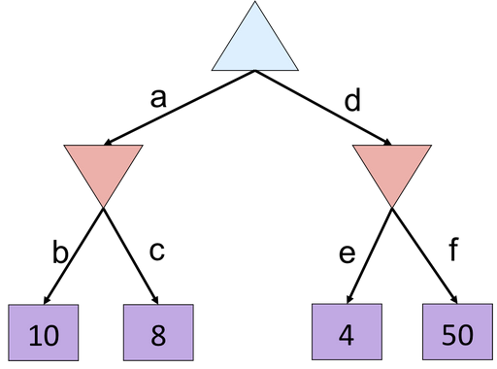
Alpha-Beta Quiz
Notes:
What’s the utility value of this tree?
8
What branches would terminate if we did AB pruning (L-> R)?
f

Slide 87
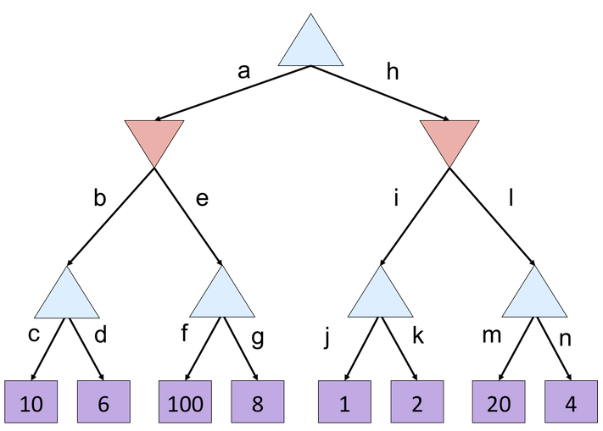
Alpha-Beta Quiz 2
Notes:
What’s the utility value of this tree?
10
What branches would terminate if we did AB pruning (L-> R)?
F & L

Slide 88
Resource Limits
Problem: In realistic games, cannot search to leaves!
Solution: Depth-limited search
Instead, search only to a limited depth in the tree
Replace terminal utilities with an evaluation function for non-terminal positions
Example:
Suppose we have 100 seconds, can explore 10K nodes / sec
So can check 1M nodes per move
α-β reaches about depth 8 – decent chess program
Guarantee of optimal play is gone
More plies makes a BIG difference
Use iterative deepening for an anytime algorithm
max
4
-2
4
min
-1
-2
4
9
?
?
?
?

Slide 89
Depth Matters
Evaluation functions are always imperfect
The deeper in the tree the evaluation function is buried, the less the quality of the evaluation function matters
An important example of the tradeoff between complexity of features and complexity of computation
[Demo: depth limited (L6D4, L6D5)]

Slide 90
Next Time: Uncertainty!

